Slide 1
INFO 6210 SECTION 04 HOSPITAL MANAGEMENT SYSTEM
Name: Leandra Menezes
NUID: 001621189
PROF NAME: Chaiyaporn Mutsalklisana
TA: Abhijeet Patil

Slide 2
ENTITIES INVOLVED
Employee : An employee can be a doctor or a nurse.
Nurse: – nurse has attributes like nurse_id and nurse_department(ANS, BNS)
Doctor: – doctor has attributes like doctor_id, doctor_specialization (Anesthesiologist, Endocrinologist)
Patient: – patient has attributes like patient_id, patient_name, and other patient details
Testlog: – contains test conducted on the patient and the type of test
Accounts: – has attributes like accounts_case_no, admit date and discharge date
Doctor_examines_patient: – contains doctor_id and patient_id

Slide 3
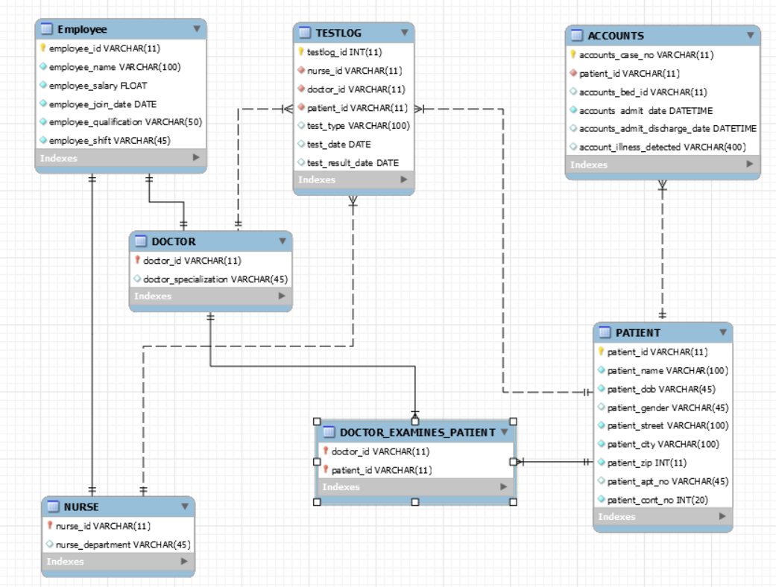
ENCHANCED ENTITY RELATIONSHIP

Slide 4

CREATE AND Drop DATABASE
The create and drop schema is used to create new database.
It first checks whether hospital management system exists and if it does it drops the database.
It then creates a database with database name hospital_mgmt_sys.

Slide 5
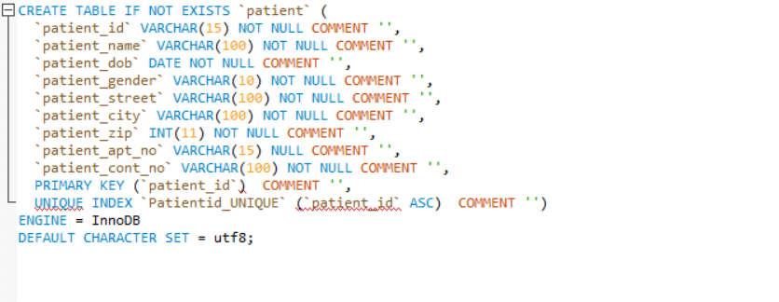
CREATE TABLE
The create table is used to create a table in MySQL.
The syntax for it is CREATE TABLE table_name (column_name column_type);
In the hospital management system a table is created named patient with attributes like patient_id, patient_name,patient_dob etc with data types like VARCHAR, INT, DATE.

Slide 6

USE DB
The use db query tells the MySQL to use this database as a default database for the subsequent queries.
After the ‘USE hospital_mgmt-sys’ is used the subsequent queries are on this database.

Slide 7
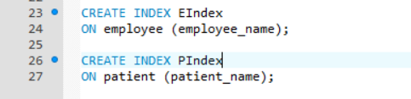
INDEX
A database index is a data structure that improves the speed of operations in a table.
In the hospital management system, an index is created on employee table and patient table on attributes employee_name and patient_name.

Slide 8
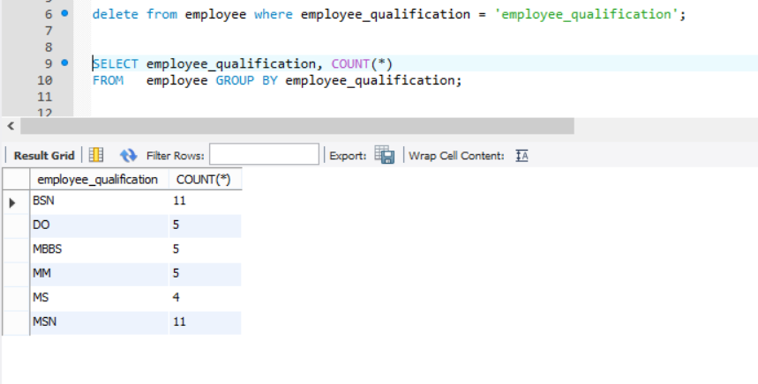
SELECT-FROM-WHERE-GROUP BY
The GROUP BY statement is used in conjunction with the aggregate functions to group the result-set by one or more columns.
The query selects employee-qualification along with count function to group by employee based on qualification

Slide 9
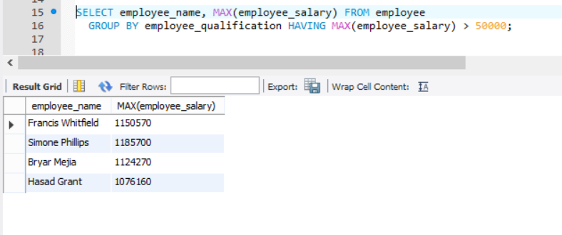
SELECT-FROM-WHERE-GROUP BY- HAVING
The HAVING clause was added to SQL because the WHERE keyword could not be used with aggregate functions.
It selects employee names whose maximum salary is above 50000

Slide 10
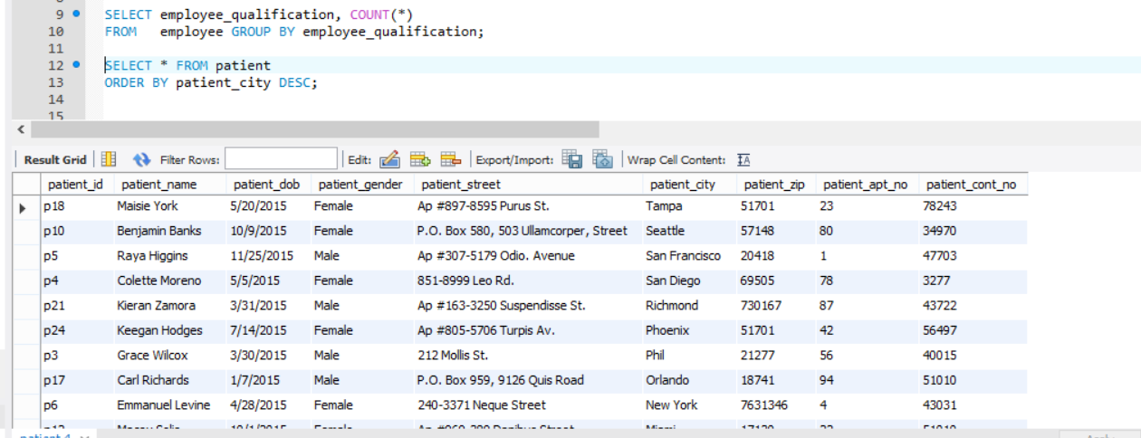
ORDER BY
The ORDER BY keyword is used to sort the result-set by one or more columns.
The ORDER BY keyword sorts the records in ascending order by default.
For eg: The query selects all columns from patient table and sorts the patient city in descending order

Slide 11
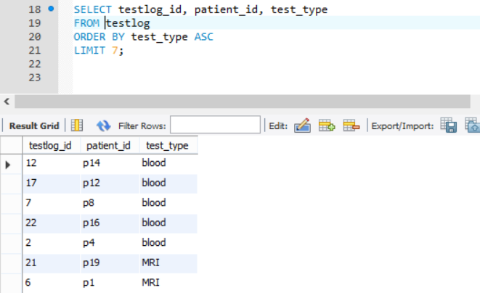
LIMIT
The LIMIT clause in MySQL is used in the select statement to constraint the number of rows in a result set.
In the query the result is limited to 7 rows.

Slide 12
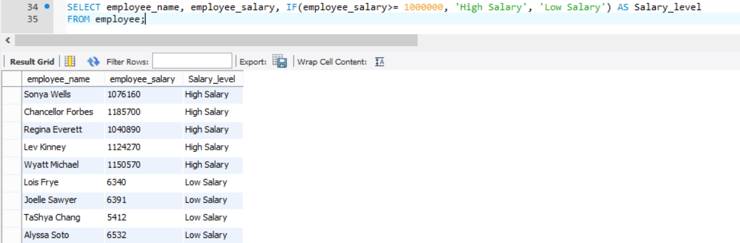
FUCNTIONS - IF
The MySQL IF statement allows you to execute a set of SQL statements based on a certain condition or value of an expression
The query puts a if condition to check if salary is above 100000 then the result would be categorized as high salary else as low salary

Slide 13
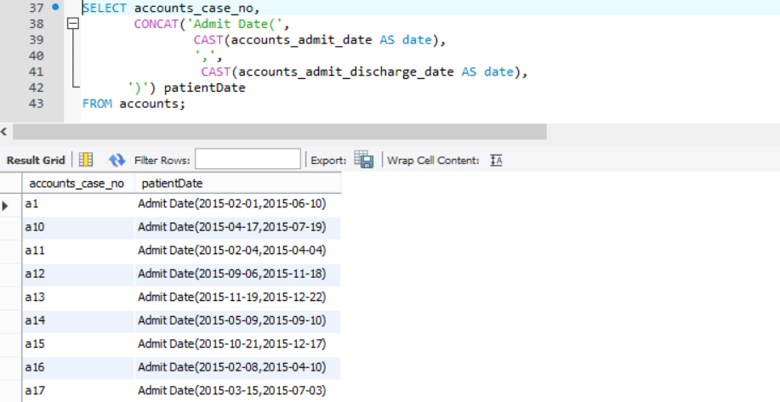
FUNCTIONS – CONCAT,CAST
The CAST function converts a value of any type into a value that has a specified type. The target type can be any one of the following types : BINARY, CHAR, DATE, DATETIME, TIME, DECIMAL, SIGNED, UNSIGNED
Here the cast function casts the admit_date and discharge_date from datetime to date format.

Slide 14
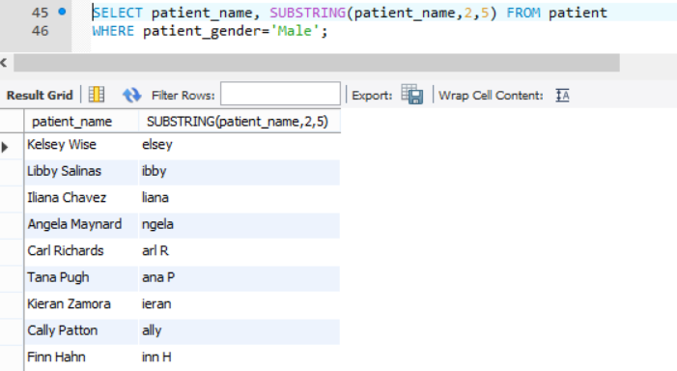
SUBSTRING
MySQL SUBSTRING() returns a specified number of characters from a particular position of a given string.
The query returns the patient_name starting from position 2 to position 5

Slide 15
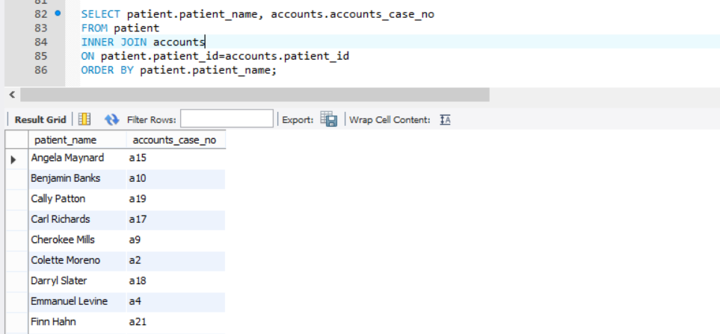
INNER JOIN
The INNER JOIN keyword selects all rows from both tables as long as there is a match between the columns in both tables.
The inner join in the hospital management systems joins patient and accounts tables based on patient_id. The select statements displays the patient_name and accounts_case_no matching to the inner join result.

Slide 16
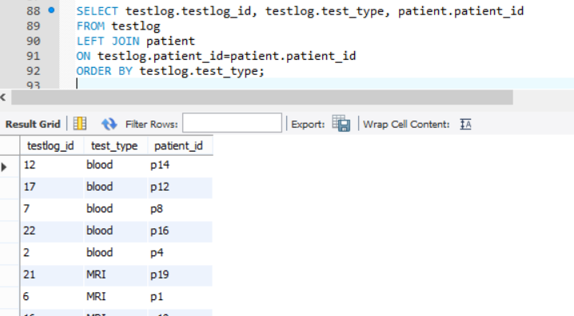
LEFT JOIN
The LEFT JOIN keyword returns all rows from the left table (table1), with the matching rows in the right table (table2). The result is NULL in the right side when there is no match.
Here the left join is performed on patient and testlog table and result is displayed on the basis of matching rows from both the table using patient_id.

Slide 17
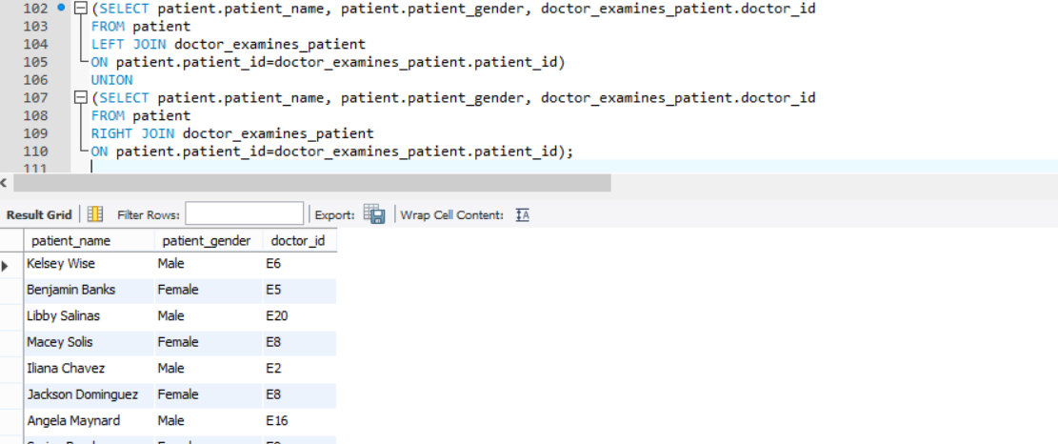
FULL JOIN
A full join is not supported in MySQL instead a left join union right join is the solution to this.
So first a left join in performed on patient and doctor_examines_patient table.
A right join between patient and doctor_examines_patient table is then performed.
A UNION of both the right and left join then displays the full join

Slide 18
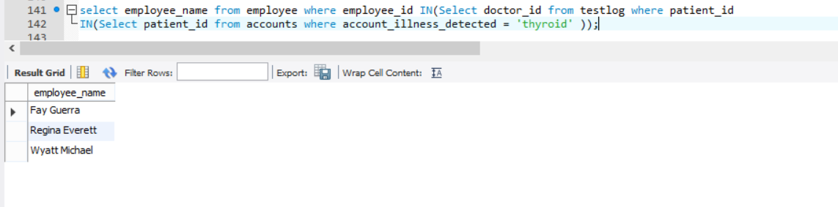
SUBQUERIES
A MySQL subquery is a query that is nested inside another query such as SELECT, INSERT, UPDATE or DELETE. In addition, a MySQL subquery can be nested inside another subquery.
The query returns the doctor names who treat thyroid

Slide 19
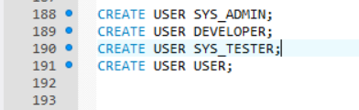
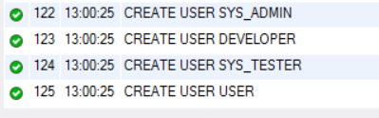
USER Privileges- CREATE USER
The primary function of the MySQL privilege system is to authenticate a user who connects from agiven host and to associate that user with privileges on a database such as select, insert, update and delete.
The hospital management system has users suchs as SYS_ADMIN, DEVELOPER, SYS_TESTER, USER

Slide 20
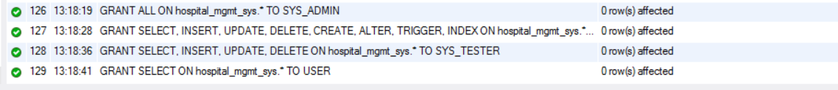
GRANT
The GRANT statement grants privileges to MySQL user accounts. GRANT also serves to specify other account characteristics as use of secure connections and limits on access to server resources.
The system admin has access to everything, developer has the right to select, update, delete, create, alter, trigger, and index on.
The system tester has the right to select, insert, update and delete
The user has the option to just select on hospital management databse system.

Slide 21
REVOKE
In order to revoke privileges from an account, you use the MySQL REVOKE statement.
Using the REVOKE statement takes away all the access rights given to users.

Slide 22

DROP USER
The DROP USER statement removes one or more MySQL accounts and their privileges.
By using the DROP USER, the user no longer exists in the database system.

Slide 23
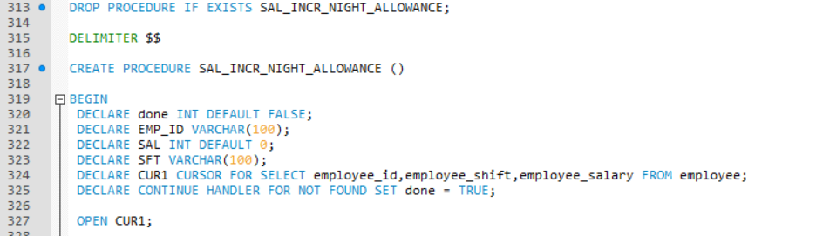
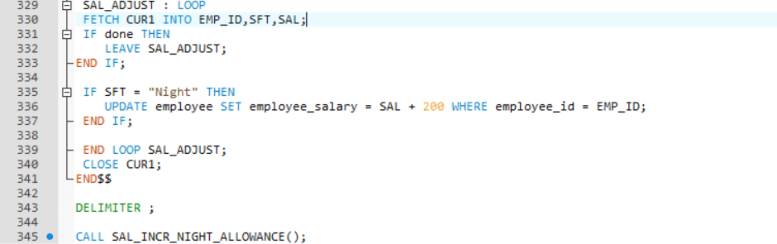
STORED PROCEDURES
A stored procedure is a method to encapsulate repetitive tasks. They allow for variable declarations, flow control and other useful programming techniques.
The stored procedure SAL_INCR_NIGHT_ALLOWANCE determines whether an employee is in night shift, and if he is, then there is an increase in his salary by $200.

Slide 24
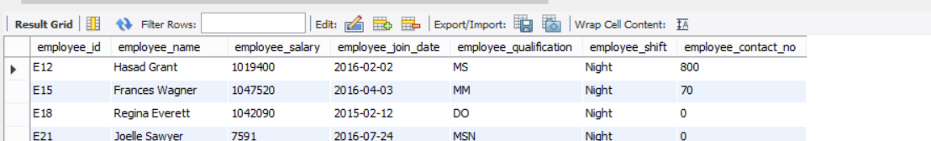
STORED PROCEDUE
After executing this stored procedure, in order to call the stored procedure use CALL SAL_INCR_NIGHT_ALLOWANCE
The result set shows the employee_salary increment by $200

Slide 25
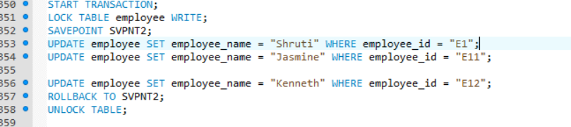
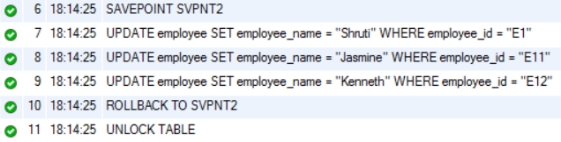
COMMIT-ROLLBACK
START TRANSACTION - to create a transaction – COMMIT, ROLLBACK statements - to end it
The COMMIT statement - saves changes to the database
The ROLLBACK statement - will undo any changes made during the transaction and database is reverted to the pre-transaction state

Slide 26
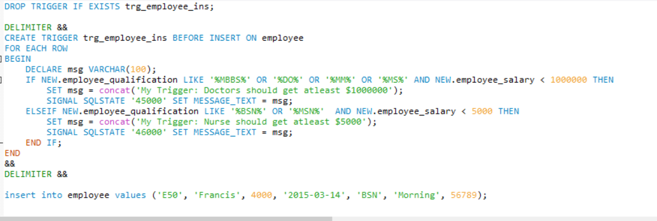
TRIGGER ON INSERT
A trigger or database trigger is a stored program that is executed automatically to respond to a specific event associated with table e.g., insert, update or delete.
The trigger above checks if the salary entered meets the minimum requirement of the salary. If the user enters data which does not match the requirement it will throw an error.

Slide 27
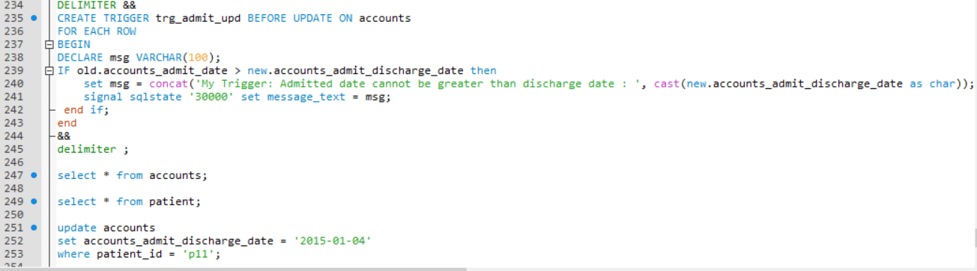
UPDATE TRIGGER
The update trigger has two type before update and after update. The before update trigger checks whether the admitted date is greater than the discharge date. If it is greater it does not allow the data to be entered.

Slide 28
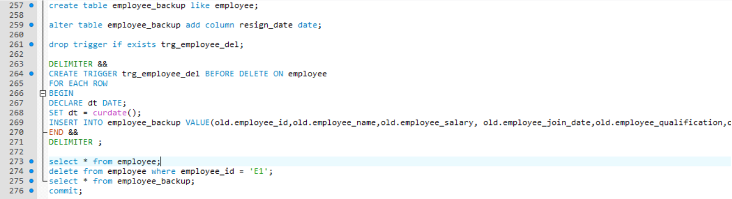
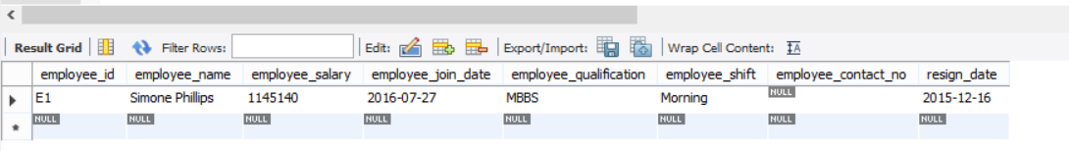
DELETE TRIGGER
The delete trigger maintains a backup of deleted record in the employee backup table so that all the record which get deleted get stored there.

Slide 29
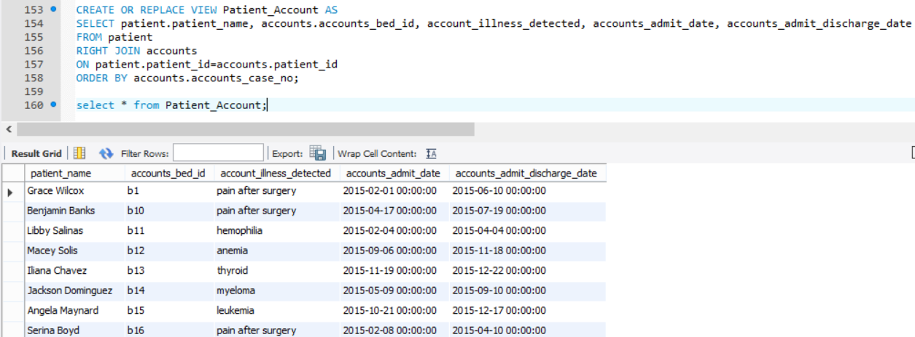
VIEW
A view contains rows and columns, just like a real table. The fields in a view are fields from one or more real tables in the database.
The view in the snapshot contains a view for patient name, accounts bed is, illness detected, admit date and discharge date from patient table right join accounts table

Slide 30
THANK YOU!

